Slide 1
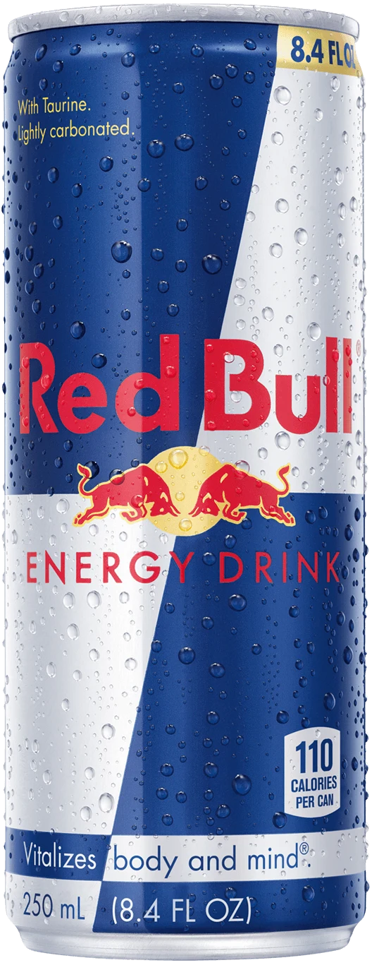
RED BULL & EMRECO
Few more steps towards growth

Slide 2
Executive summary
This presentation is basically about how one of the red bull’s most loyal and famous accounts EMRECO is currently managing the torrid economic backgrounds with flying colours and what we as red bull can do for them to grow them even more. Emreco has decided to grow and open more stores and us being their prime suppliers this will mean we need to help this account grow even more so that we both can grow and achieve success together.

Slide 3
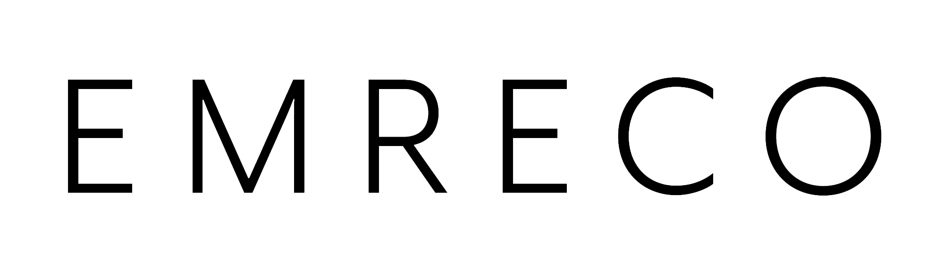
EMRECO AND THEIR CONCERNS
Their first concerns was regarding the margins that they are earning, so the data suggested that even during these torrid times they have gotten higher than average profits margins thanks to the great customers of red bull products who have procured the most amount of revenue.
Second they had concerns whether red bull and EMRECO together will lead to detriment in the brand value but data shows that red bull is one of the primary reasons of high revenue for the store
Third was a positive concern as the store was not able to match the supply to demand of the red bull products as they had a very high amount of demand and i have already communicated this to the supply incharge
FInally they believed if they should give up on cola co coolers but margins are a little higher of ours so it was advised to give up on them gradually whilst still keeping red bull coolers as primary attraction.

Slide 4
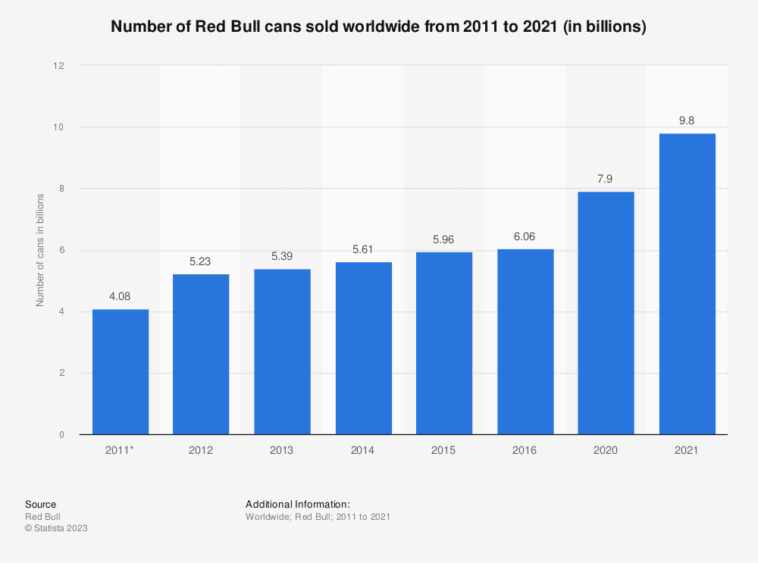
Opportunity 1: Complete focus on the supply to Emreco
EMRECO’s highest amount of sales are because of red bull products that also ship in maximum amount of revenue for them
We need to start with utter and complete supply of the red bull products as their is a high amount of demand for them
What this will do is as the demand is more we will in turn get more amount of revenues that would likely allow us to reach our final goal of opening more EMRECO stores wherein redbull would be the major contributor.

Slide 5
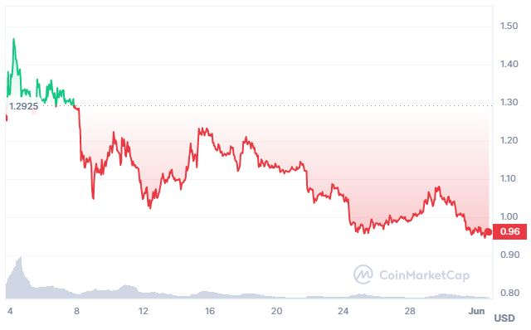
Opportunity 2: Sharing the profits and becoming partners.
Having a partnership with EMRECO would benefit both the sides as red bull is the highest revenue generator
We can increase the supply make the store a little red bull centric but not deviate the focus from other products
Revenue generated can then be used to open more EMRECO stores wherein red bull will hold certain amount of partnership
Gradually all cola co coolers can be replaced as they have a falling demand.
We can also organise red bull related events to invite traction

Slide 6
Proposed next steps
Gradually replace cola co coolers with the red bull coolers and completely replace them over a period of 2 years. Can be done sooner if revenues are higher than expected.
Propose a partnership deal with EMRECO as red bull brings in most revenue, we can propose to decrease our margin of profit in return of a partnership this will then help us open more stores in target cities thereby increasing the overall revenue for both the companies ten folds
Promote red bull centric events and promote events , this will bring in people of all cultures together and form a community. This will give the companies a customer base they can bank on whenever it matters.

Slide 7
Thank you

